Slide 1


SMART INDIA HACKATHON 2025
TITLE PAGE
Problem Statement ID – 25060
Problem Statement Title- Real life solutions for Waste Management.
Theme- Clean & Green Technology
PS Category- Software
Team ID -
Team Name (Registered on portal) – Nexus Thinkers

Slide 2
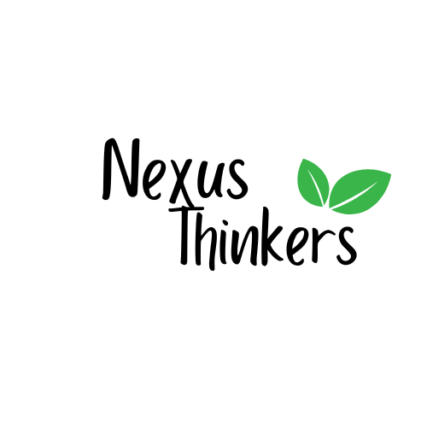
IDEA TITLE
Problem Statement:
In FY 2021–22, India generated approximately 1.7 lakh tonnes of municipal solid waste daily, of which only 54% was scientifically treated. Around 24% was dumped in landfills and 22% remained unaccounted due to leakages in the waste management chain. This unaccounted waste is often burned or disposed of in open areas, drains, or water bodies, posing severe environmental and public health risks. (CEEW, 2025) This calls for strict solutions to enable all the waste generators to contribute to Waste Management.
Our Soltuion:
AI Waste Classification – Detects & sorts household waste using AI.
Personalized Reuse & DIY Ideas – Creative tutorials for upcycling waste.
Reward System – Earn eco-points for responsible actions.
Google Maps Integration – Locate nearest recyclers & collection points.
Leaderboard & Eco-Challenges – Gamified competitions to encourage participation.
Household Focused – Simple, accessible, and user-friendly for families.

Slide 3
TECHNICAL APPROACH
Programming Languages:
JavaScript / TypeScript – for frontend (React) and backend (Node.js/Express).
React.js + Tailwind CSS – for building responsive, modern UI components with utility-first styling
Frameworks & Libraries:
Frontend: React.js (UI, state management, component-based structure)
Backend: Node.js with Express.js (API handling, server-side logic)
Hosting / Auth / Realtime DB: Firebase (user authentication, cloud storage, notifications)
APIs / AI Tools:
Genkit AI – for content generation or AI-driven functionality in your app.
Gemini API – for additional AI services (e.g., recommendations, analysis).
Google Maps API – for geolocation, mapping, and route visualization.

Slide 4
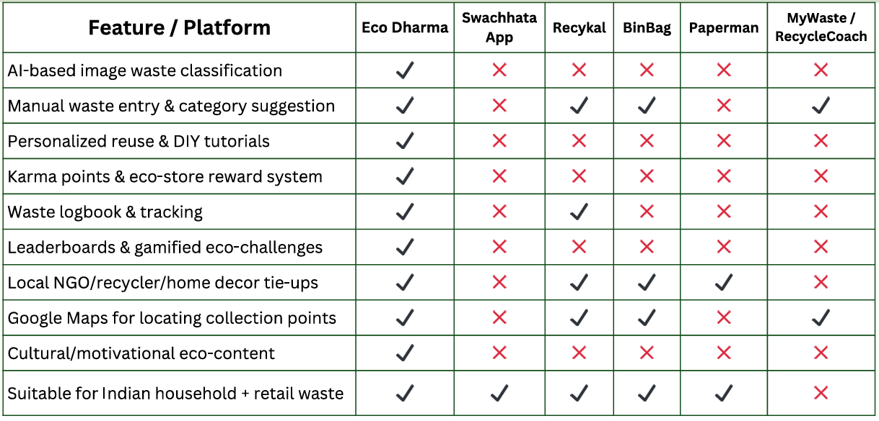
FEASIBILITY AND VIABILITY

Slide 5
IMPACT AND BENEFITS
Target Audience:
It will benefit the Households, Gated Communities and Organisations to manage waste by creating a clean environment.
Social Impact:
Leaderboard and Gamified Challenges are used to create an Active competition in society to join the hands for cleaning environment.
Environmental Impact:
Makes the environment neat and clean by recycling the waste.
This can reduce the environmental pollution.

Slide 6
RESEARCH AND REFERENCES
CPCB. Annual Report on Solid Waste Management, 2021–22.
https://cpcb.nic.in/uploads/MSW/MSW_AnnualReport_2021-22.pdf
CEEW. How can Indian Cities Boost Sustainable Solid Waste Management Practices.
https://www.ceew.in/publications/how-can-indian-cities-boost-sustainable-solid-waste-management-practices
CEEW. Plastic Waste Recycling — State of Practice, Jobs & Opportunities.
https://www.ceew.in/plastic-waste-recycling
Source:
https://github.com/Vinod63021/eco-dharma
https://github.com/Manikanta18apr/EcoDharma

